Slide 1
Unit 3
MICROBIOLOGY

Slide 2
History and development of microbiology
Microbiology is the study of microorganisms / microbes which is visible only with a microscope. The diverse group of organisms includes algae, archae, bacteria, cyanobacteria, fungi, protozoa, viruses. Most of the microorganisms are harmless. 99% are good. Eg: cynobacteria (blue green algae) 1% are bad. Eg: pathogens
Era’s: 1) discovery era 2)transition era 3) golden era 4) modern era
Discovery era: “spontaneous generation” aristotle (384-322) and others believed that living organisms could develop from non-living materials. In 13th century, rogen bacon described that the disease caused by a minute “seed” or “germ”. Antony van leeuwenhoek (1632 – 1723)descriptions of protozoa, basic types of bacteria, yeasts and algae. In 1676, he observed and described microorganisms such as bacteria and protozoa as “animalcules”. The term microbe is used by sedillot in 1878.
Transition era: Francesco redi (1626 - 1697). He showed that maggots would not arise from decaying meat, when it is covered. John needham (1713 – 1781). Supporter of the spontaneous generation theory. He proposed that tiny organism(animalcules) arose spontaneously on the mutton gravy. He covered the flasks with cork as done by redi, still the microbes appeared on mutton broth. Lazzaro spallanzai (1729 – 1799). He demonstrated that air carried germs to the culture medium. He showed that boiled broth would not give rise to microscopic forms of life.
Golden era: louis Pasteur: He is the father of medical microbiology. He pointed that no growth took place in swan neck shaped tubes because dust and germs had been trapped on the walls of the curved necks but if the necks were broken off so that dust fell directly down into the flask, microbial growth commenced immediately. Pasteur in 1897 suggested that mild heating at 62.8°C (145°F) for 30 minutes rather than boiling was enough to destroy the undesirable organisms without ruining the taste of the product, the process was called pasteurization. He invented the processes of pasteurization, fermentation and the development of effective vaccines (rabies and anthrax). Pasteur demonstrated diseases of silkworm was due to a protozoan parasite. Contributions of loius pasteur: He coined the term “microbiology”, aerobic, anaerobic. He disproved the theory of spontaneous germination. He demonstrated that anthrax was caused by bacteria and also produced the vaccine for the disease.

Slide 3
John tyndall (1820 - 1893) :he discovered highly resistant bacterial structure, later known as endospore. Prolonged boiling or intermittent heating was necessary to kill these spores, to make the infusion completely sterilized, a process known as tyndallisation. Lord joseph lister (1827-1912) He is the father of antiseptic surgery. Lister concluded that wound infections too were due to microorganisms. He also devised a method to destroy microorganisms in the operation theatre by spraying a fine mist of carbolic acid into the air.
Robert koch (1893-1910) : He demonstrated the role of bacteria in causing disease. He perfected the technique of isolating bacteria in pure culture. Robert koch used gelatin to prepare solid media but it was not an ideal because (i) since gelatin is a protein, it is digested by many bacteria capable of producing a proteolytic exoenzyme gelatinase that hydrolyses the protein to amino acids. (ii) it melts when the temperature rises above 25°C. Koch's postulates
Fanne eilshemius hesse (1850 - 1934) : one of koch's assistant first proposed the use of agar in culture media. It was not attacked by most bacteria. Agar is better than gelatin because of its higher melting pointing (96°c) and solidifying (40 – 45°c)points. Richard petri (1887)  he developed the petri dish (plate), a container used for solid culture media.
Edward jenner (1749-1823): first to prevent small pox. He discovered the technique of vaccination. Alexander flemming.he discovered the penicillin from penicillium notatum that destroy several pathogenic bacteria. Paul erlich (1920). He discovered the treatment of syphilis by using arsenic. he studied toxins and antitoxins in quantitative terms & laid foundation of biological standardization.

Slide 4
Microbes in us and their role in human health and disease
There is a mighty but invisible kingdom of microbes present within your body.
Small yet incredibly powerful, these thousands of species and trillions of inhabitants live in all parts of your body and make up the diverse human microbiome.
These microbiomes support and maintain your health but also, when the microbiome is disturbed in some fashion, have been linked to hundreds of ailments such as cancers, and autoimmune and cardiovascular diseases.
Micro-organisms, or microbes for short, are very small living creatures.
Magnification x1600 when the image is printed 10 cm high. The tip of the pin is approximately 20 µm across and the bacteria are around 5 µm long. Most of them cannot be seen without using a microscope.
They are classified into 5 different groups: algae protozoa bacteria fungi viruses illustration of microbes.

Slide 5
Only a small number cause disease, many more are helpful.
Microbes play a key role in maintaining life on earth, fixing gases and breaking down dead plant and animal matter into simpler substances that are used at the beginning of the food chain.
Their activity is exploited for the production of medicines, food and enzymes.
They are used to breakdown sewage and other wastes.
Infection and disease
What is a pathogen? : Pathogen is a micro-organism that has the potential to cause disease.
What is an infection? : An infection is the invasion and multiplication of pathogenic microbes in an individual or population. What is disease? Disease is when the infection causes damage to the individual’s vital functions or systems. An infection does not always result in disease.
How do microbes reach us? The cycle of transmission involves > Escape from the host or reservoir of infection > Transport to the new host > Entry to the new host > Escape from the new host > continues

Slide 6
How do microbes get in?
Portals of entry to cause an infection , microbes must enter our bodies. The site at which they enter is known as the portal of entry . Microbes can enter the body through the four sites listed below:
Resipiratory tract (mouth and nose) e.g Influenza virus
Gastrointestinal tract (mouth oral cavity) e.g Vibrio cholerae
Urogenital tract e.G Escherichia coli
Break s in the skin surface e.G. Clostridium tetani

Slide 7
Koch's postulates
Koch's postulates are four criteria designed to establish a causative relationship between a microbe and a disease.
The postulates were formulated by Robert koch and friedrich loeffler in 1884, based on earlier concepts described by jakob henle, and refined and published by koch in 1890.
Koch applied the postulates to describe the etiology of cholera and tuberculosis.
The postulates have been controversially generalized to other diseases.
More modern concepts in microbial pathogenesis cannot be examined using koch's postulates, including viruses (asymptomatic carriers)
Koch's postulates are the following:
The microorganism must be found in abundance in all organisms suffering from the disease, but should not be found in healthy organisms.
The microorganism must be isolated from a diseased organism and grown in pure culture.
The cultured microorganism should cause disease when introduced into a healthy organism.
The microorganism must be reisolated from the inoculated, diseased experimental host and identified as being identical to the original specific causative agent.

Slide 8
VACCINES: Types
The first human vaccines against viruses were based using weaker or attenuated viruses to generate immunity.
The smallpox vaccine used cowpox, a poxvirus that was similar enough to smallpox to protect against it but usually didn’t cause serious illness.
Rabies was the first virus attenuated in a lab to create a vaccine for humans.
Vaccines are made using several different processes.
They may contain live viruses that have been attenuated (weakened or altered so as not to cause illness); inactivated or killed organisms or viruses; inactivated toxins (for bacterial diseases where toxins generated by the bacteria, and not the bacteria themselves, cause illness); or merely segments of the pathogen (this includes both subunit and conjugate vaccines).

Slide 9
The different vaccine types each require different development techniques. Each section below addresses one of the vaccine types.
1) Live, attenuated vaccines
Attenuated vaccines can be made in several different ways.
Some of the most common methods involve passing the disease-causing virus through a series of cell cultures or animal embryos (typically chick embryos).
Using chick embryos as an example, the virus is grown in different embryos in a series. With each passage, the virus becomes better at replicating in chick cells, but loses its ability to replicate in human cells.
All of the methods that involve passing a virus through a non-human host produce a version of the virus that can still be recognized by the human immune system, but cannot replicate well in a human host.
When the resulting vaccine virus is given to a human, it will be unable to replicate enough to cause illness, but will still provoke an immune response that can protect against future infection.

Slide 10
Killed or inactivated vaccines
One alternative to attenuated vaccines is a killed or inactivated vaccine.
Vaccines of this type are created by inactivating a pathogen, typically using heat or chemicals such as formaldehyde or formalin.
This destroys the pathogen’s ability to replicate, but keeps it “intact” so that the immune system can still recognize it.
Because killed or inactivated pathogens can’t replicate at all, they can’t revert to a more virulent form capable of causing disease (as discussed above with live, attenuated vaccines).
However, they tend to provide a shorter length of protection than live vaccines, and are more likely to require boosters to create long-term immunity.
Toxoids
Some bacterial diseases are not directly caused by a bacterium itself, but by a toxin produced by the bacterium.
One example is tetanus: its symptoms are not caused by the clostridium tetani bacterium, but by a neurotoxin it produces (tetanospasmin).
Immunizations for this type of pathogen can be made by inactivating the toxin that causes disease symptoms.
As with organisms or viruses used in killed or inactivated vaccines, this can be done via treatment with a chemical such as formalin, or by using heat or other methods.
Immunizations created using inactivated toxins are called toxoids. Toxoids can actually be considered killed or inactivated vaccines, but are sometimes given their own category to highlight the fact that they contain an inactivated toxin, and not an inactivated form of bacteria.

Slide 11
Subunit and conjugate vaccines
Both subunit and conjugate vaccines contain only pieces of the pathogens they protect against.
Subunit vaccines use only part of a target pathogen to provoke a response from the immune system.
This may be done by isolating a specific protein from a pathogen and presenting it as an antigen on its own. The acellular pertussis vaccine and influenza vaccine (in shot form) are examples of subunit vaccines.
Another type of subunit vaccine can be created via genetic engineering.
Conjugate vaccines are somewhat similar to recombinant vaccines: they’re made using a combination of two different components.
Conjugate vaccines, however, are made using pieces from the coats of bacteria. These coats are chemically linked to a carrier protein, and the combination is used as a vaccine.
Conjugate vaccines are used to create a more powerful, combined immune response: typically the “piece” of bacteria being presented would not generate a strong immune response on its own, while the carrier protein would.
The piece of bacteria can’t cause illness, but combined with a carrier protein, it can generate immunity against future infection. The vaccines currently in use for children against pneumococcal bacterial infections are made using this technique.

Slide 12
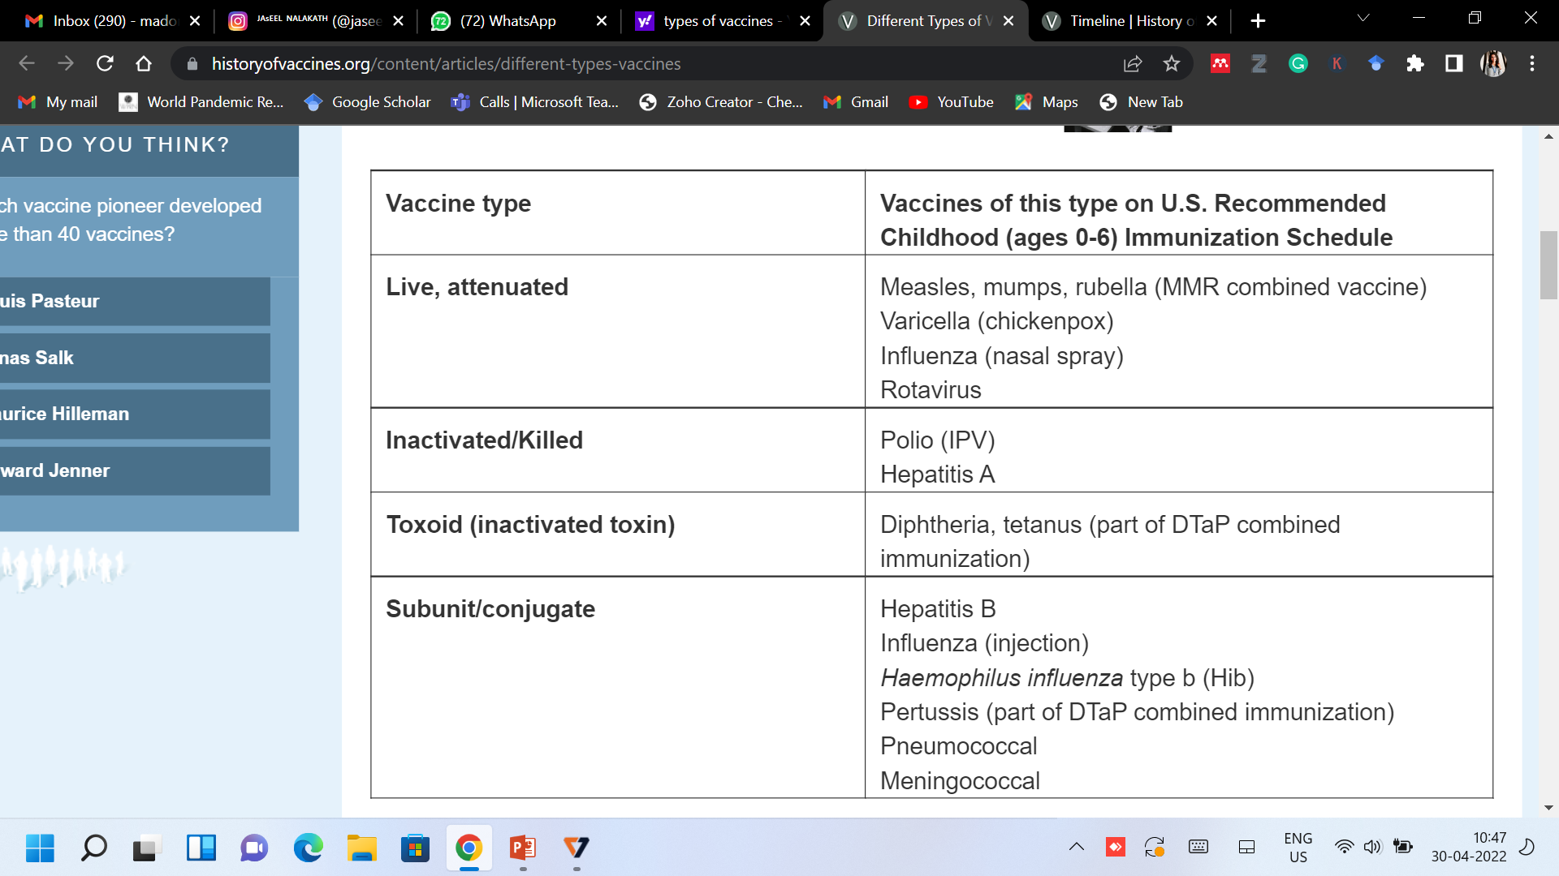
2) Medication
A number of medications have been approved for the treatment of substance abuse.
These include replacement therapies such as buprenorphine and methadone as well as antagonist medications like disulfiram and naltrexone in either short acting, or the newer long acting form.
Several other medications, often ones originally used in other contexts, have also been shown to be effective including bupropion and modafinil.
Methadone and buprenorphine are sometimes used to treat opiate addiction.
^{T}hese drugs are used as substitutes for other opioids and still cause withdrawal symptoms but they facilitate the tapering off process in a controlled fashion.

Slide 13
Control of Microbial Growth
The control of microbial growth is necessary in many practical situations, and significant advances in agriculture, medicine, and food science have been made through study of this area of microbiology.
"Control of microbial growth", as used here, means to inhibit or prevent growth of microorganisms. This control is affected in two basic ways:
by killing microorganisms or (2) by inhibiting the growth of microorganisms.
Control of growth usually involves the use of physical or chemical agents which either kill or prevent the growth of microorganisms. Agents which kill cells are called cidal agents; agents which inhibit the growth of cells (without killing them) are referred to as static agents. Thus, the term bactericidal refers to killing bacteria, and bacteriostatic refers to inhibiting the growth of bacterial cells. A bactericide kills bacteria, a fungicide kills fungi, and so on.
In microbiology, sterilization refers to the complete destruction or elimination of all viable organisms in or on a substance being sterilized.
There are no degrees of sterilization: an object or substance is either sterile or not. Sterilization procedures involve the use of heat, radiation or chemicals, or physical removal of cells.

Slide 14
Methods of Sterilization
Heat: most important and widely used. For sterilization one must consider the type of heat, and most importantly, the time of application and temperature to ensure destruction of all microorganisms. Endospores of bacteria are considered the most thermoduric of all cells so their destruction guarantees sterility.
Incineration: burns organisms and physically destroys them. Used for needles, inoculating wires, glassware, etc. And objects not destroyed in the incineration process.
Boiling: 100º for 30 minutes. Kills everything except some endospores. To kill endospores, and therefore sterilize a solution, very long (>6 hours) boiling, or intermittent boiling is required.
Autoclaving (steam under pressure or pressure cooker) autoclaving is the most effective and most efficient means of sterilization. All autoclaves operate on a time/temperature relationship. When proper conditions and time are employed, no living organisms will survive a trip through an autoclave.

